Slide 1
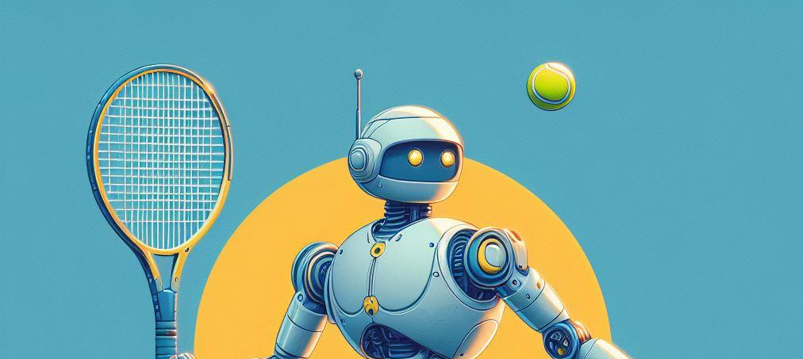
Tennis Oracle
By: Pranet Allu, Oliver Peralta, Pieter Alley

Slide 2
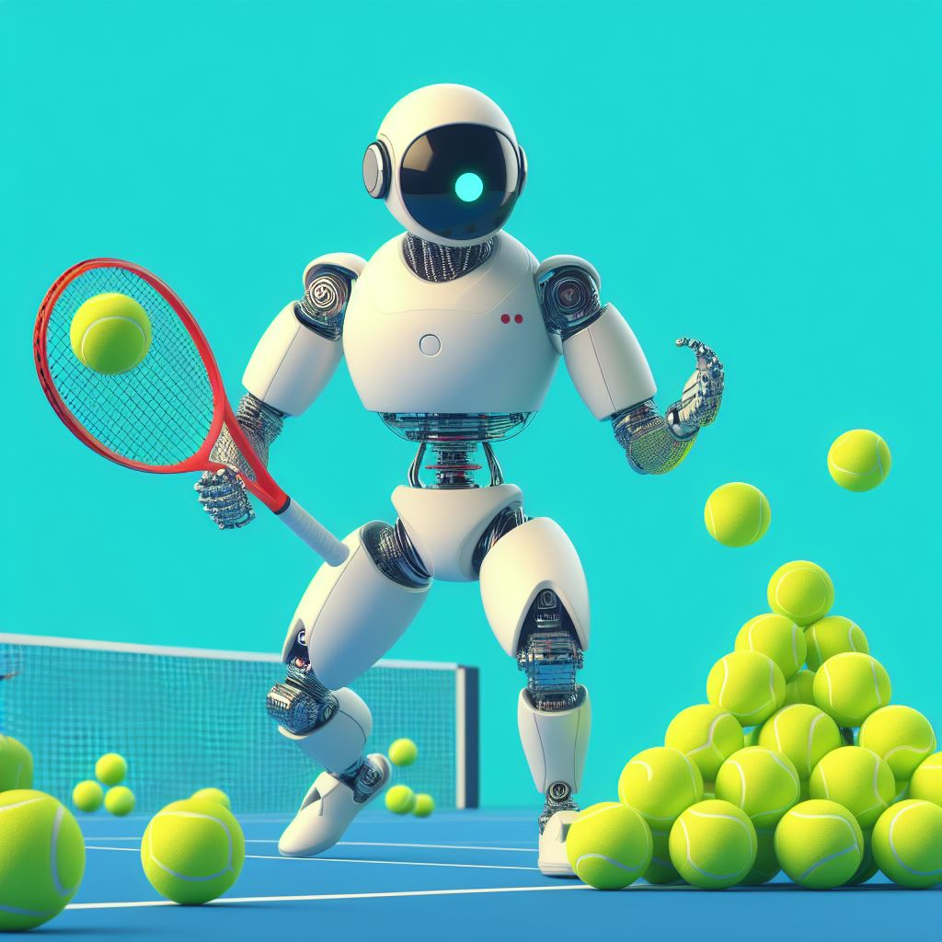
Goal
Create a model that can consistently predict the outcome of a tennis match
Use web scraping and machine learning to collect and process match data and rankings
Analyze match data for patterns in winner and losers.

Slide 3
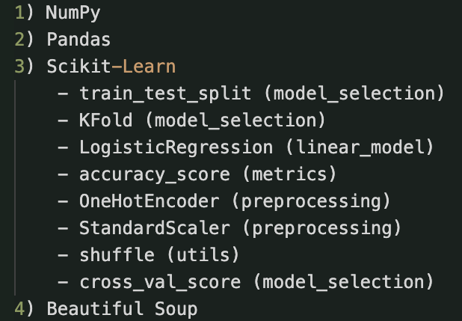
Dependencies

Slide 4
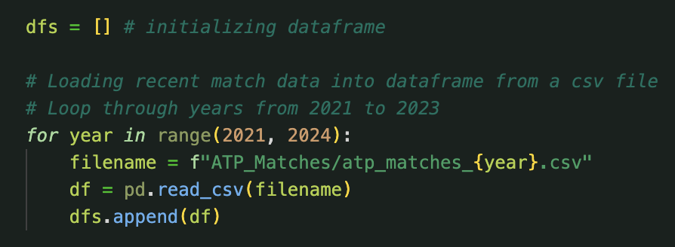
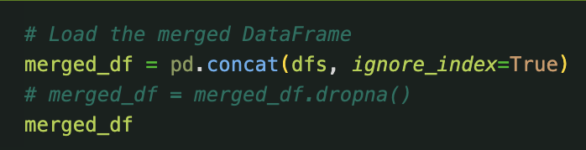
Data Preprocessing
^Reading Prior Match Data from ATP_matches file

Slide 5
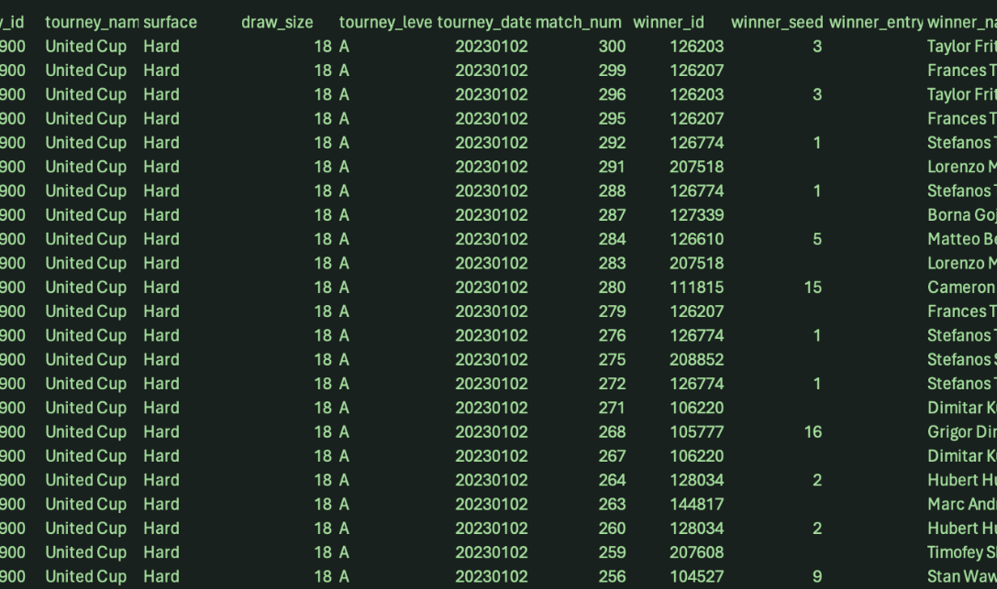
Data Preprocessing

Slide 6
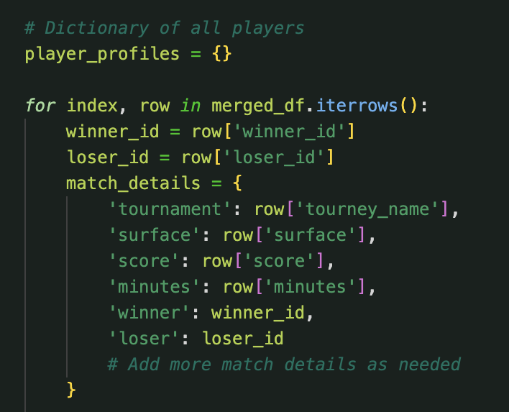
Data Preprocessing
Prior Match Data Attributes:
Tournament name
Court Surface
Final Score
Length of Game
Winner
Loser

Slide 7
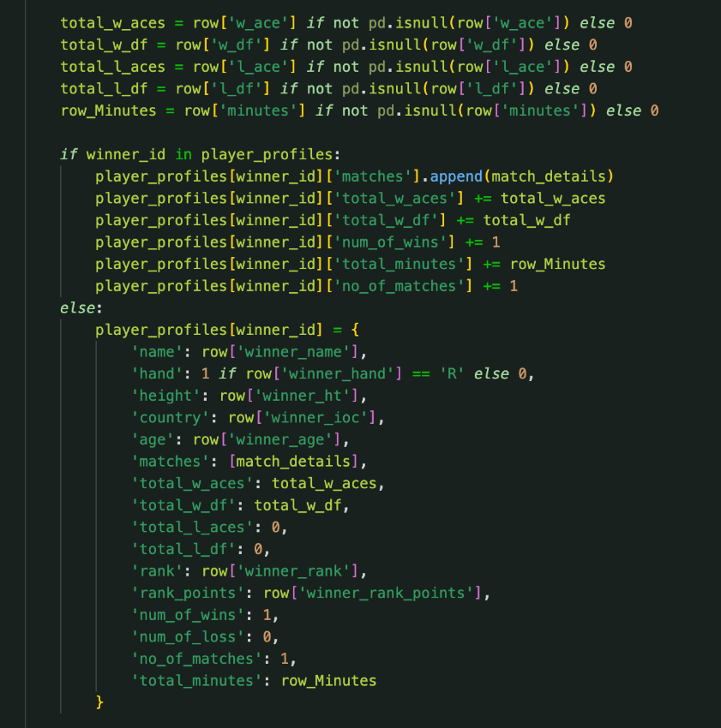
Data Preprocessing
Some rare data:
Aces for winner and loser
Time length of each row
Building Player Profiles:
Name
Dominant Hand
Height
Country of Origin
Win Ratio
Ranking
Total Minutes Played
Age

Slide 8
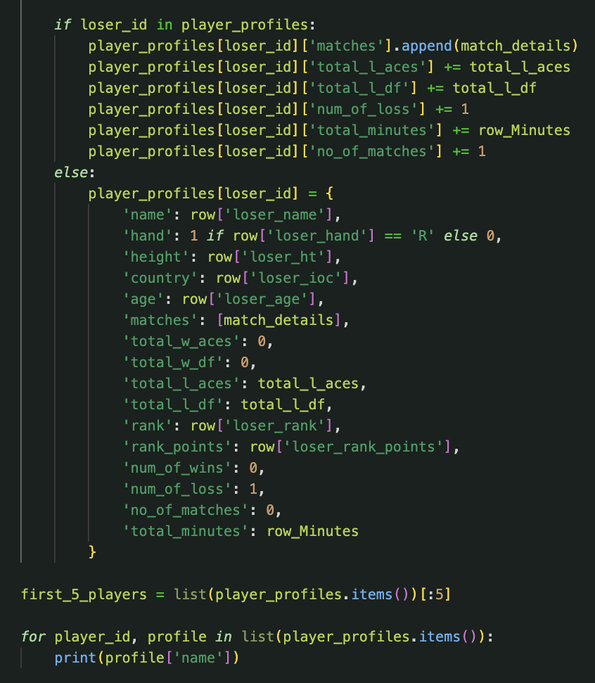
Data Preprocessing
<Doing the same for the losing player

Slide 9
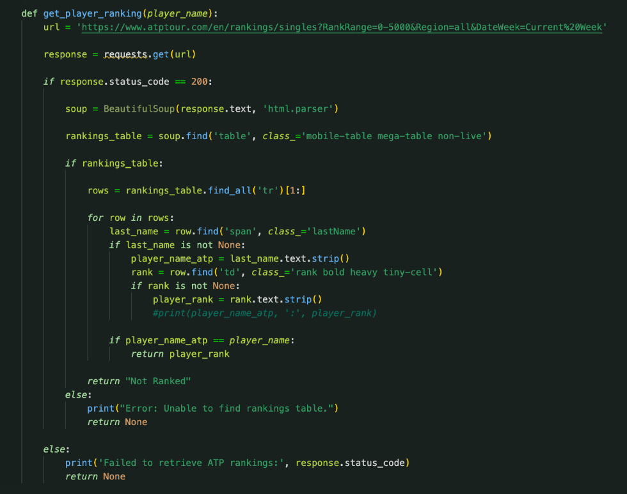
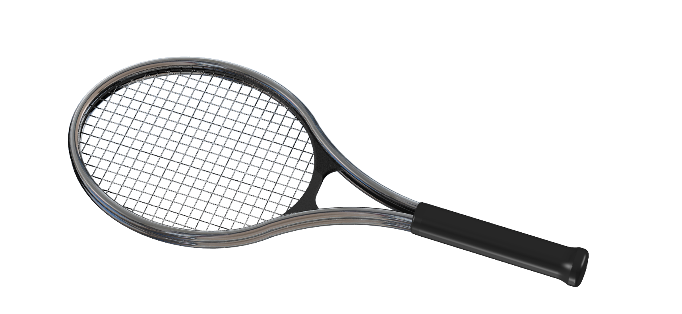
Web Scraping
Ethical web scraping to ensure respect for public/private data
Rankings for top 2000 currently active players

Slide 10
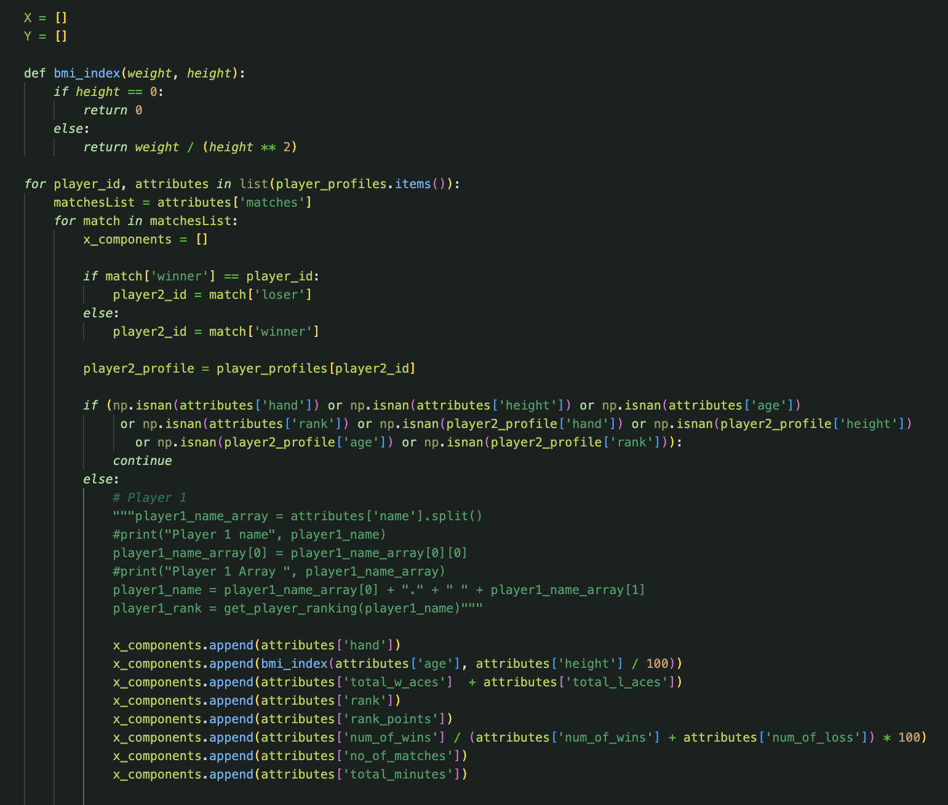
Data Preprocessing
<Collecting player data from dictionaries into data frames

Slide 11
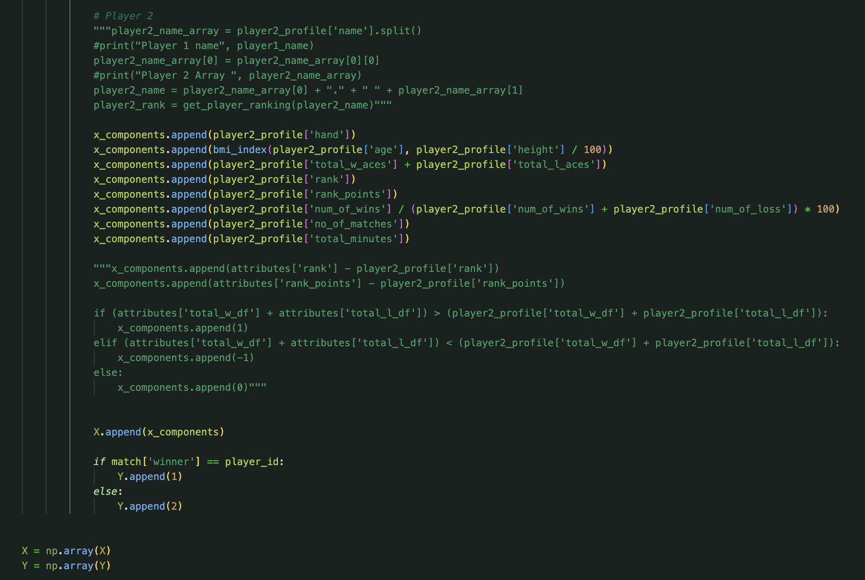
Data Preprocessing
<Doing the same for player 2
<Target: Who won the game?

Slide 12
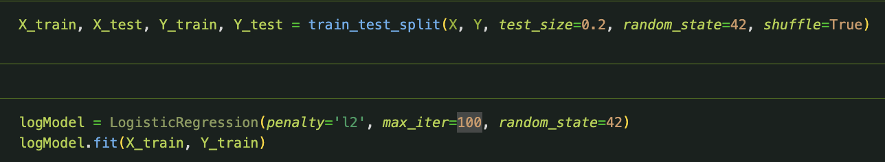
Modeling
^Splitting the data into training and testing sets
^Creating logistic regression model and fitting it to the training data

Slide 13
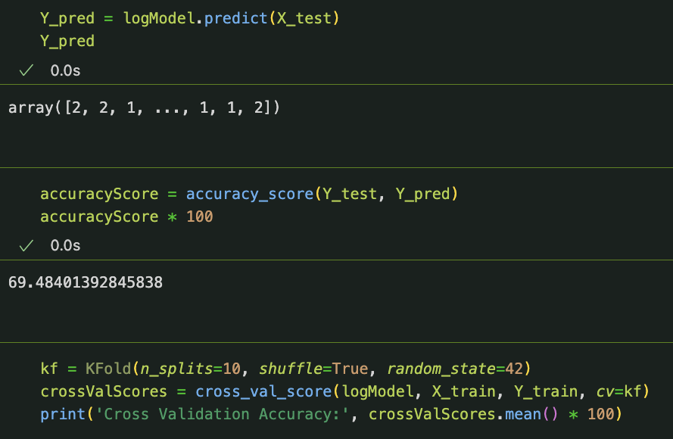
Results
Our model has an accuracy of ~70%
Which is better than a coin toss, and can be improved with more data and parameters.

Slide 14
Thanks for watching :D

